Slide 1
Counselor Lesson: Week 4
Coping Mechanisms for Stress and Self-Care

Slide 2
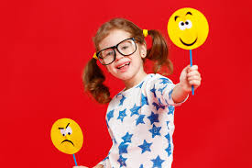
Introduction
Sometimes feelings can seem to “spill out” of us because we can have so many of them at one time. Having to stay at home so much might be making you have lots of different feelings. Taking care of our emotions and bodies is a great way to help us feel better. When we feel good, we are able to learn and get along with others better.

Slide 3
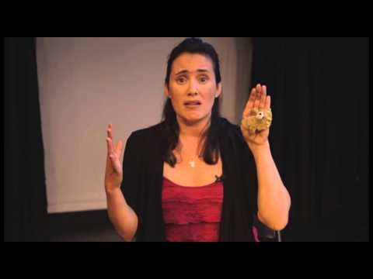
After watching this video, we will have a better understanding of how our brain works and helps us show our feelings..

Slide 4
Next, we are going to do an activity…
Cup of feelings--
Are you happy to get to stay home? Do you feel sad if you think about your friends and teachers? Are you excited that you have more time to ride bikes and play with your family? Maybe you feel worried about when we will get back to school or what if your school work is too hard?
It’s helpful to think about how “big” each of those feelings are and how much of that feeling you have. Then you can start to manage how you feel a little bit better.

Slide 5
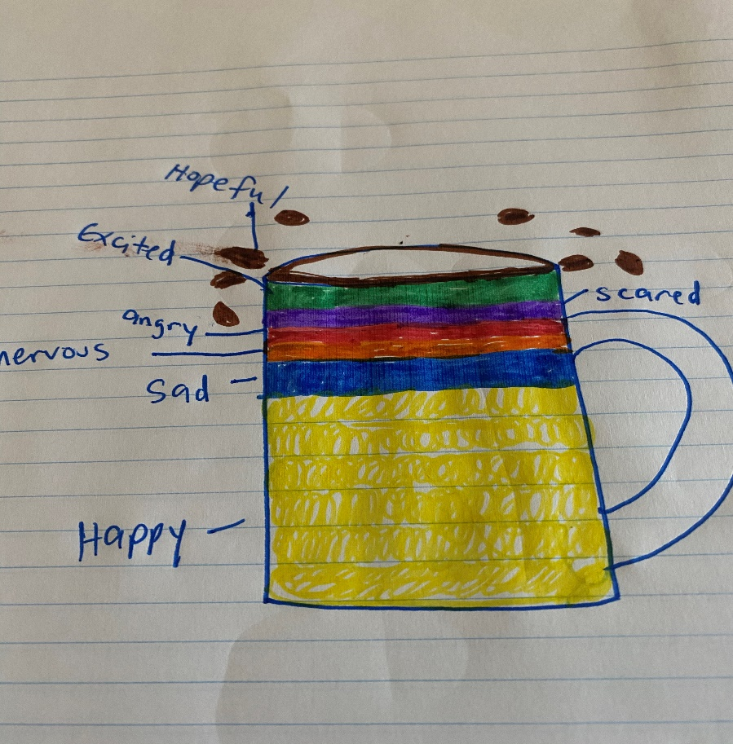
On a piece of paper, draw a picture of a cup, then use colors to show how much of each feeling you have inside. You can add your own feelings and give them your own colors, too.
yellow=happy red=angry purple=scared pink=hopeful orange=nervous blue=sad green=excited

Slide 6
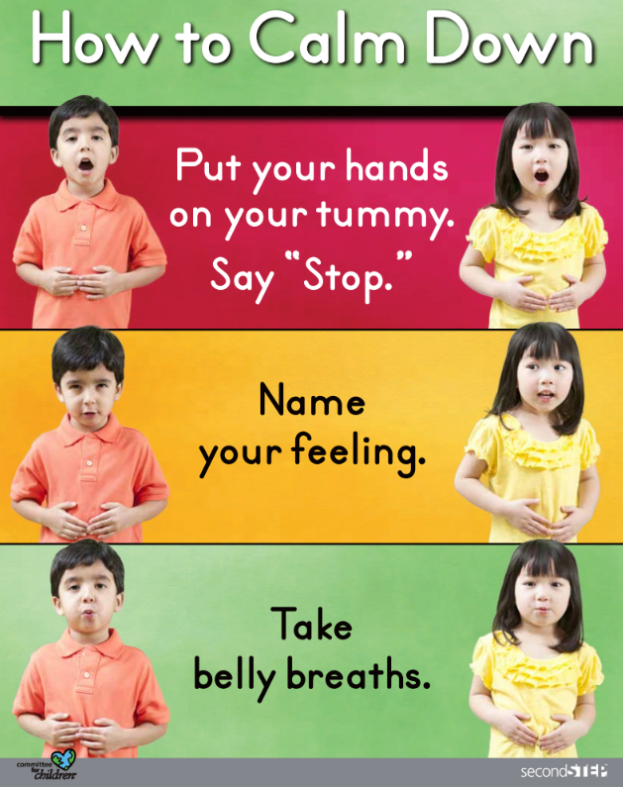
Talk to a grown up about the feelings and what makes you feel like this. You and your grown up can talk about what you can do if things start to “spill out” and things feel like they are too much.
When our feelings start to spill out, we can…

Slide 7
Remember we all feel stressed at times, so stop and take a break if you are feeling overwhelmed. Use some of the ideas you learned about in this lesson to help Yourself calm down, so you can feel better. Click HERE for the full lesson and more resources and techniques on calming down

